Slide 1
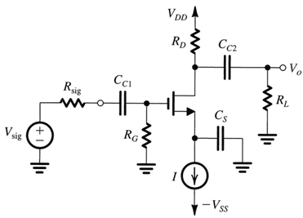
Quiz 4.2
Deadline: April 17, 2020
a) Fig. 1 shows the Mosfet circuit with R_{D} = R_{L} = 10 kΩ, R_{sig} = 50 kΩ, R_{G} = 3MΩ, C_{gs} = 5 pF, C_{gd} = 2 pF and g_{m} = 2 mA/V. All capacitors C_{C1}, C_{C2}, and C_{s} are considered as short circuits.
Find unity-gain frequency of the transistor MOSFET (NOT the circuit).
Find C_{eq} using Miller effect.
Find the upper 3-dB frequency f_{H} of the voltage gain v_{o}/v_{sig.}
Find the voltage gain A_{M} = v_{o}/v_{sig} at middle frequency.
Estimate the voltage gain v_{o}/v_{sig} at 2f_{H}. (Use concept of -6dB/octave or -20dB/decade)
Plot the Bode plot of A(jω) = v_{o}/v_{sig} and give sufficient information on the graph.
Fig. 1

Slide 2
b) Fig. 2 shows the BJT circuit with R_{C} = R_{L} = 5 kΩ, R_{sig} = 2 kΩ, R_{B} = 82kΩ, r_{x} = 50Ω, C_{π} = 20pF, C_{μ} = 5pF, I_{c} = 1mA and β_{o} = 100. All capacitors C_{C1}, C_{C2}, and C_{s} are considered as short circuits
Find unity-gain frequency of the transistor BJT (NOT the circuit).
Find C_{eq} using Miller effect.
Find the upper 3-dB frequency f_{H}.
Find the voltage gain A_{M} = v_{o}/v_{sig} at middle frequency
Plot the Bode plot of A(jω) = v_{o}/v_{sig} and give sufficient information on the graph.
Fig. 2

